Slide 1

Home Credit Default Risk

Slide 2
Outline
Problem Statement
Dataset
EDA and Preprocessing
Models Training

Slide 3
Problem statement
Many people struggle to get loans due to insufficient or non-existent credit histories. And, unfortunately, this population is often taken advantage of by untrustworthy lenders.

Slide 4
Dataset
Application {train/test}
Bureau
Bureau_Balance
POS_CASH_Balance
Credit_Card_Balance
Previous_Application
Installments_Payments

Slide 5
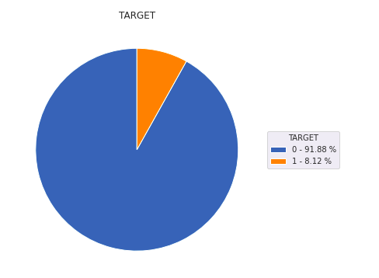
Distribution of Target Label
1

Slide 6
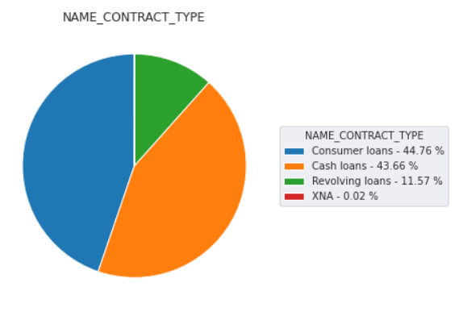
Type of Previous Loan Application

Slide 7
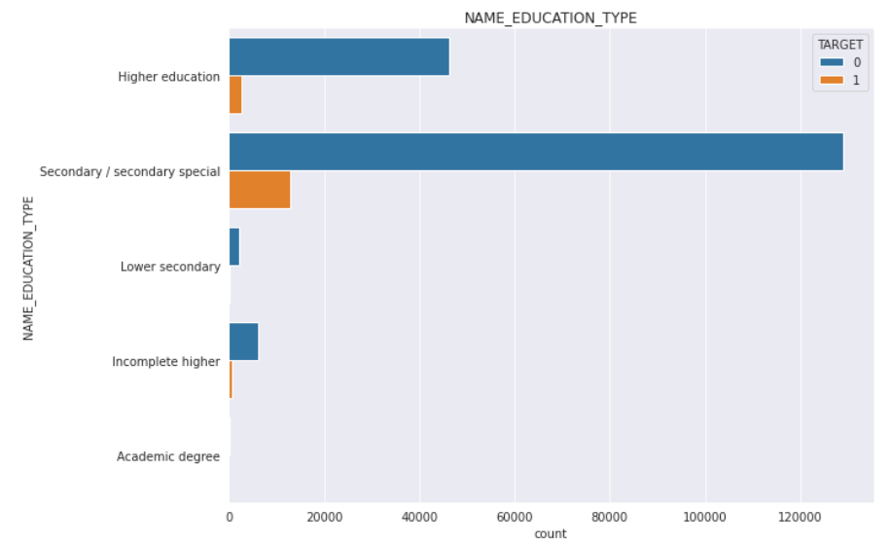
Education Type of Applicants

Slide 8
Handling Missing Values and Outlier
Values which are out of Inter-Quantile range are replaced by NAN values
Numerical Columns : Median
Categorical Columns : Mode

Slide 9
Data Encoding:
One Hot Encoding
Frequency Encoding

Slide 10
Training: Part A
Model | Area Under ROC
Random Forest | 0.70592
LGBM :Dart | 0.74939
LGBM: Goss | 0.75276
LGBM: Stratified KFold | 0.75294
LGBM: Blend | 0.75692

Slide 11
Part B:
In-Memory Optimisation of DataFrame
Dataset | DataFrame Usage Before Modification | DataFrame Usage After Modification
Application_train | 186 MB | 45MB
Bureau_balance | 624 MB | 624 MB
Bureau | 222 MB | 184 MB
Credit_card_balance | 673 MB | 275 MB
Installments_payment | 830 MB | 371 MB
POS_CASH_balance | 610 MB | 231 MB
Prev_application | 471 MB | 236MB
TOTAL | 3,616 MB | 1544 MB

Slide 12
ROC Score
For Part B
Model | Area Under ROC
LGBM : GBDT | 0.77918
LGBM: DART | 0.78425
LGBM : GBDT with 30000 estimators | 0.78503

Slide 13
Feature Engineering
Min, Max, Median, Variance of Attributes of Other datasets while Joining
Income_Credit_Percentage = Income / Credit
Family_Income = Income / Count_of_Family_Members
Annuity Percentage = Annuity / Income
Family Annuity = Annuity / Count_of_Family Members
Annuity_Period = Credit / Annuity

Slide 14
Weighted Average Smoothing
Three different Models were trained and Weighted average of Results of Individually Trained Model were taken:
Model | W1 | W2 | W3 | Area Under ROC
Vanilla Model After Feature Engineering |  |  |  | 0.78809
 | 0.3 | 0.4 | 0.3 | 0.78881
 | 0.2 | 0.7 | 0.1 | 0.78884
 | 0.25 | 0.6 | 0.15 | 0.78890

Slide 15
Project Summary:
Exploratory Data Analysis
Handling Missing Values
Training
Hyperparameter Tuning / Feature Selection
Weighted Average of Top 3 Performing Model
User testing

Slide 16
Questions?

